Slide 1
MODULE-1: Networking principles and layered architecture

Slide 2
PROTOCOLS & STANDARDS
DATA COMMUNICATION AND NETWORKING

Slide 3
Protocols
Network Protocols
Set of rules that governs/used for communication. The key elements are given below.
1. Syntax: structure/format of the data. Meaning the order in which the data is present.
2. Semantics: The meaning of each section of bits.
3. Timing: Refers to two characteristics: - When data should be sent and how fast they can be sent.

Slide 4
How it works?
Network protocols take large-scale processes and break them down into small, specific tasks or functions.
Each layer is assigned a functions
This occurs at every level of the network and each function must cooperate at each level to complete the larger task at hand.

Slide 5
List of Network protocols
Communication
Network management
Security

Slide 6
Communication Protocol
Communication Protocol is a system of rules that allow two or more entities of a communications system to transmit information via any kind of variation of a physical quantity.

Slide 7
Network Management Protocol: SNMP
An Internet Standard protocol for
collecting and organizing information about managed devices on IP networks
modifying that information to change device behavior.
Devices that typically support SNMP include cable modems, routers, switches, servers, workstations, printers, and more.

Slide 8
Network security protocols
Ensures the security and integrity of data in transit over a network connection.
Network security protocols define the processes and methodology to secure network data from any illegitimate attempt to review or extract the contents of data.

Slide 9
Popular Protocols
ISDN - Integrated Services Digital Network. Communication protocol offered by phone companies which allows phone networks to carry voice, video, and data.
CDMA - Code Division Multiple Access. X.25 - ITU’s standard that defines how connections between terminal equipment and computers are maintained.
TCP/IP (Transmission Control Protocol/Internet Protocol) suite
ARP (Address Resolution Protocol)
DNS (Domain Name System)
FTP (File Transfer Protocol)
HTTP (Hyper Text Transfer Protocol)
HTTPS (Hypertext Transfer Protocol Secure)
ICMP (Internet Control Message Protocol)
IGMP (Internet Group Management Protocol)
IMAP4 (Internet Message Access Protocol version 4)

Slide 10
Standards
Standard provides a model for development that makes it possible for a product to work regardless of the individual manufacturer
Dejure – haven’t approved by organized body, but adopted as standards through wide spread use ASCII USB
Defacto - Proprietary and Non proprietary
Proprietary – invented by commercial organizations; close off communications
Non proprietary-developed by groups or committees; open standards QWERTY
International Standard Organization (ISO)
International Telecommunications Union- Telecommunications Standard Sector (ITU-T)
American National Standards Institute (ANSI)
The Institute of Electricals and Electronic Engineering (IEEE)
The Electronic Industries Association (EIA)

Slide 11
List of Standard Organizations
International Standard Organization (ISO). Responsible for a wide range of standards including networking standards.
CCITT - Consultative Committee for International Telegraph and Telephone. Responsible for development of Communication standards.
International Telecommunications Union-Telecommunications Standards Sector (ITU-T) - develops worldwide standards for telecommunication technologies.
American National Standard Institute (ANSI)
Institute of International Electrical and Electronics Engineers (IEEE)
Electronic Industries Association (EIA)
Telecommunications Industry Association (TIA) and other leading telecommunication companies worked cooperatively to create ANSI/TIA/EIA-568-A standard for commercial buildings.

Slide 12
OSI MODEL
DATA COMMUNICATION AND NETWORKING

Slide 13
The OSI Model
OSI - “Open Systems Interconnection".
Open communication between different systems without requiring changes to the underlying architecture.
Introduced in 1984 by the International Organization for Standardization (ISO).
Outlines WHAT needs to be done to send data from one computer to another
is a theoretical blueprint that helps us understand how data gets from one user’s computer to another.
helps develop standards so that all of our hardware and software talks nicely to each other.

Slide 14
Why a layered model ?
Breaks down communication into smaller, simpler parts.
Easier to teach communication process.
Speeds development, changes in one layer does not affect how the other levels works.
Standardization across manufactures.
Allows different hardware and software to work together.
Reduces complexity

Slide 15
Each layer has its own function and provides support to other layers.
Each layer uses services from layers below it & provides services for the layers above it.
Each layer adds its own information to the message it receives and sends the package to the next.

Slide 16
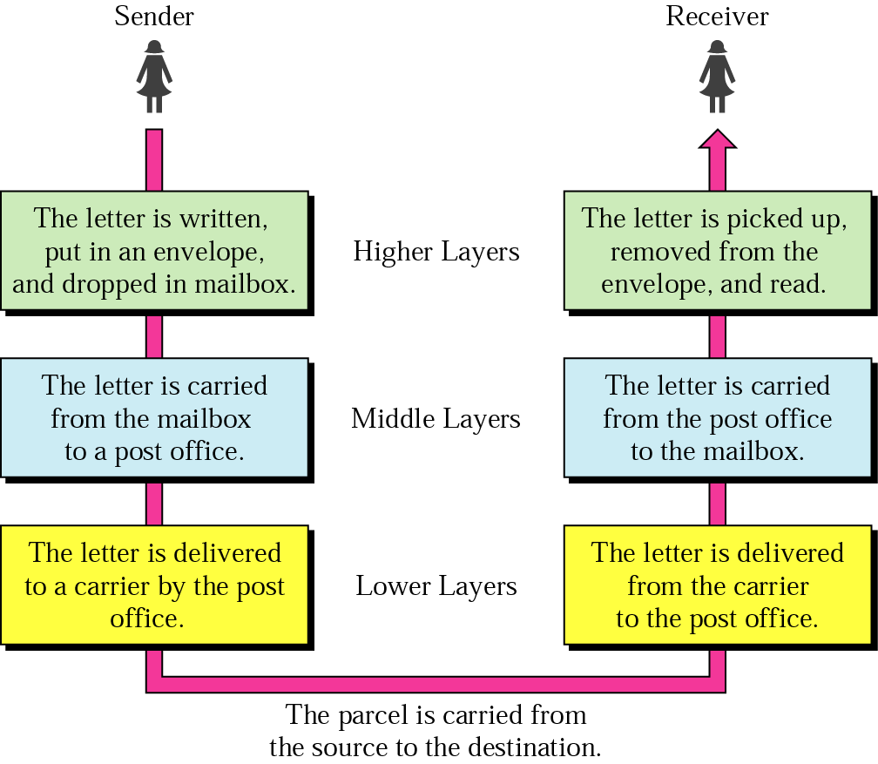
Tasks involved in sending letter

Slide 17
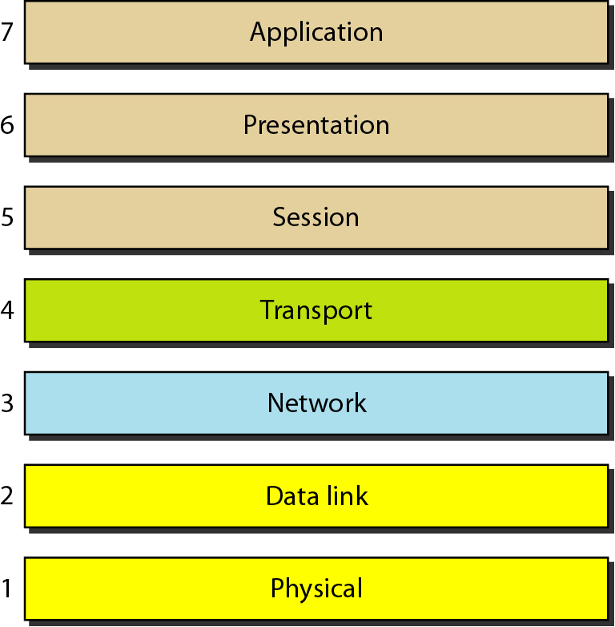
Seven layers of the OSI model
Source: Data Communications and Networking – Behrouz A. Forouzan

Slide 18
Organization of the Layers
Physical Layer
Data Link Layer Network support Layers
Network Layer (Deals with physical aspects
of moving data)
Session Layer
Presentation Layer User support Layers
Application Layer (Provides Interoperability among
unrelated s/w)
4. Transport Layer - Ensures End-to-End reliable data transmission

Slide 19
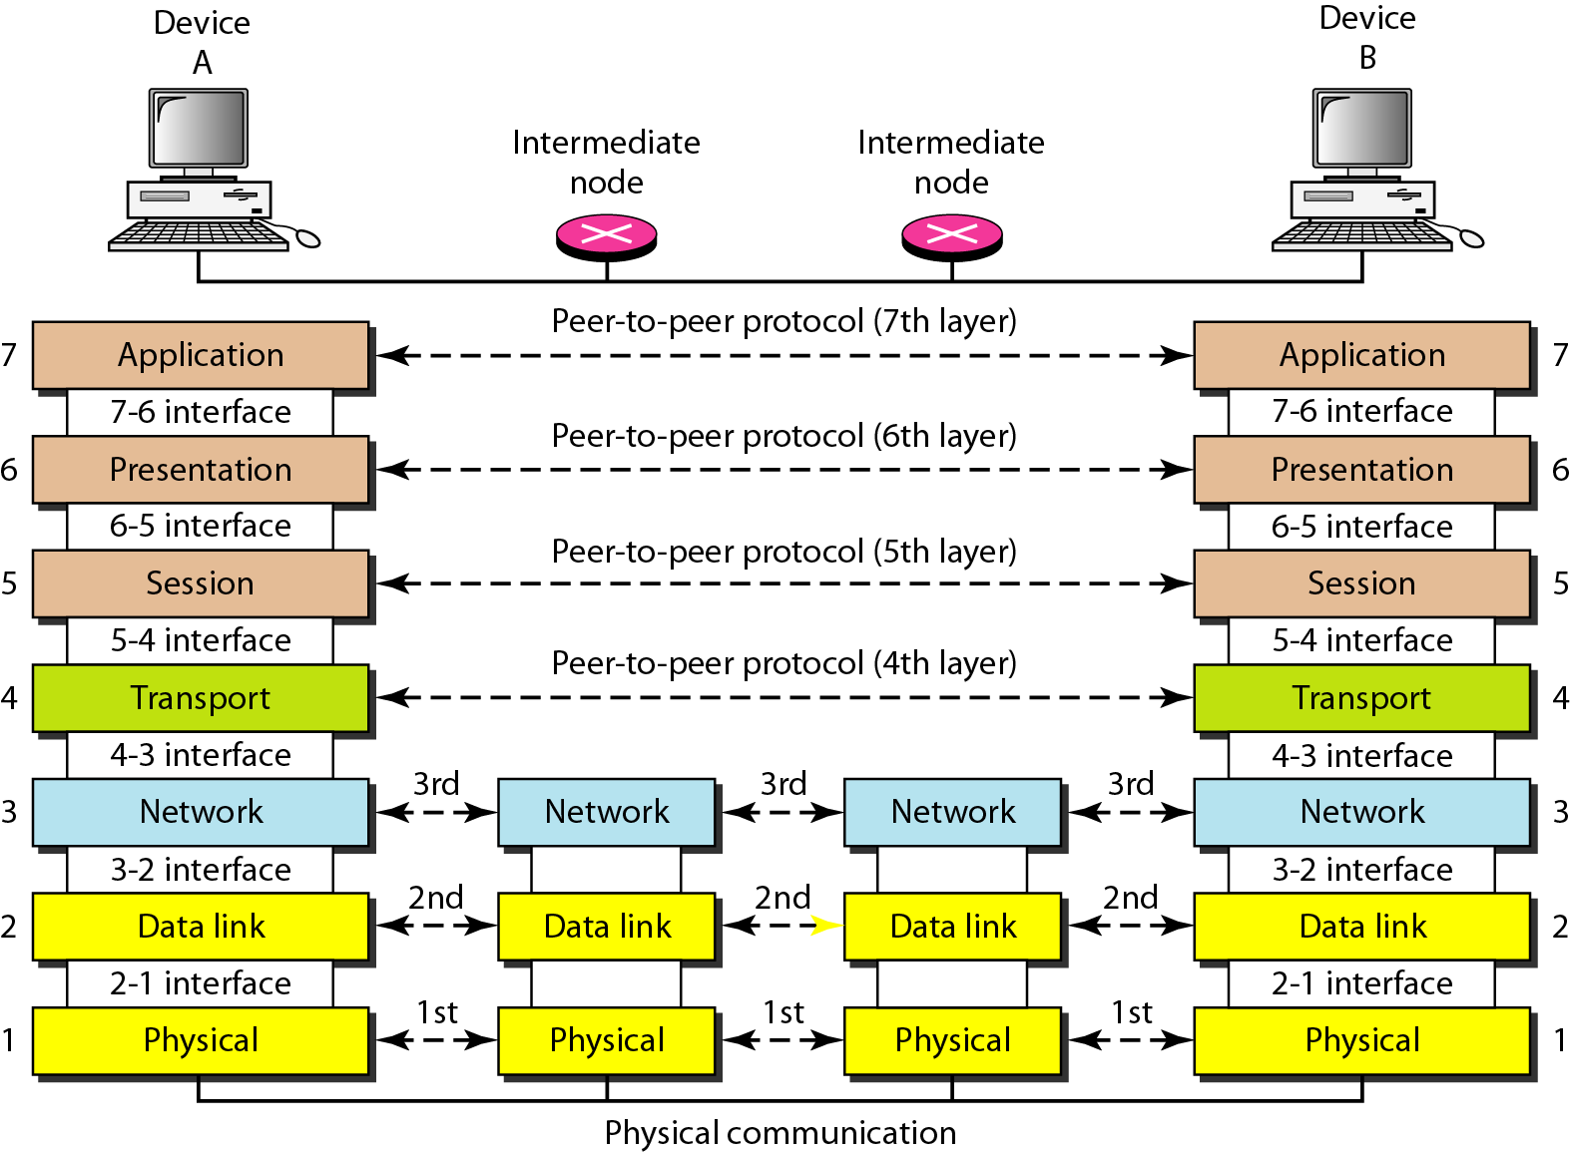
The interaction between layers in the OSI model
Source: Data Communications and Networking – Behrouz A. Forouzan

Slide 20
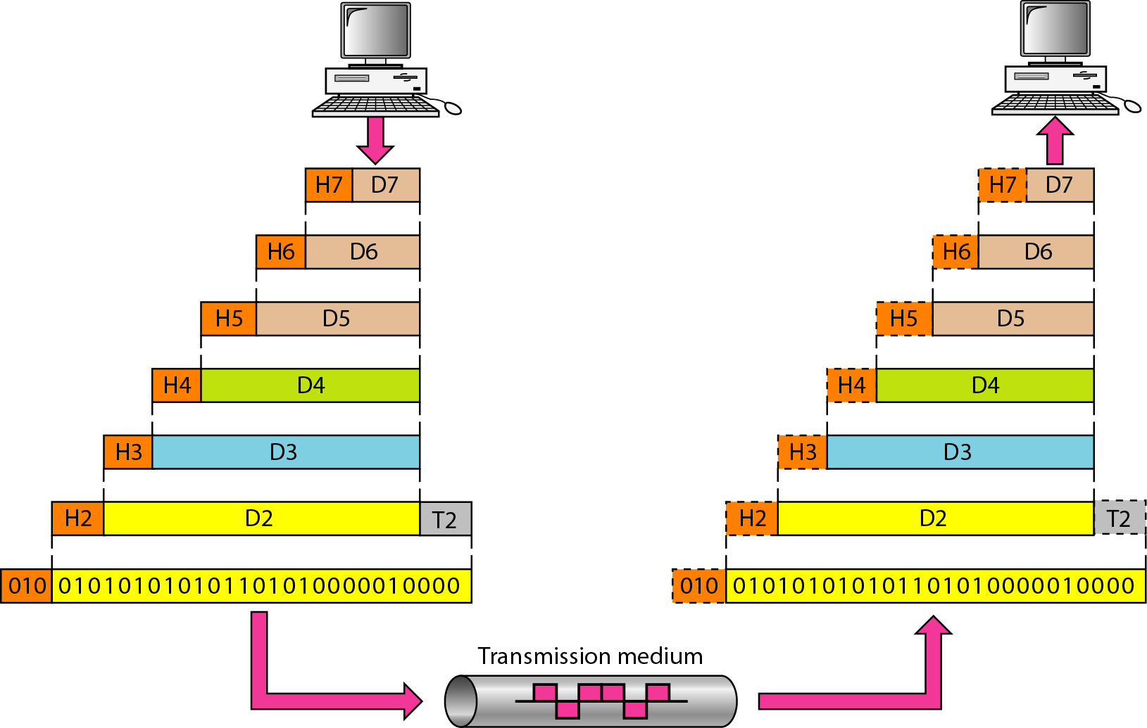
An exchange using the OSI model
Source: Data Communications and Networking – Behrouz A. Forouzan

Slide 21
Physical Layer
Responsible for transmitting individual bits from one node to the next.
bottom layer of the OSI model
unit of communication is a BIT
converts bits into electronic signals for outgoing messages
converts electronic signals into bits for incoming messages
manages interface between the computer and the network medium
Concerns about
Synchronization & Data Rate of bits
Line configuration
Physical topology
Transmission mode Ex: Network Interface Card

Slide 22
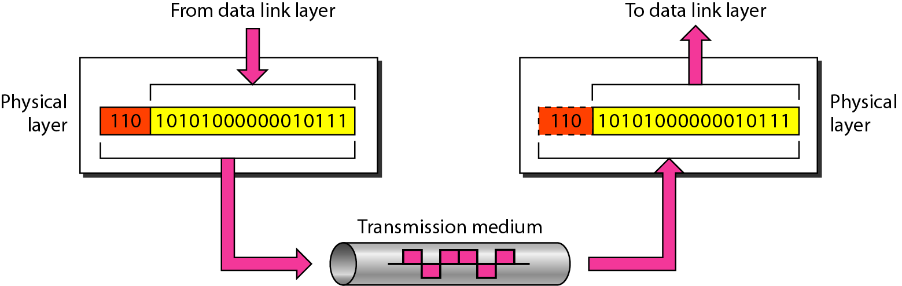
Physical layer
The physical layer is responsible for movements of
individual bits from one hop (node) to the next
Source: Data Communications and Networking – Behrouz A. Forouzan

Slide 23
Data link layer
The data link layer is responsible for transmitting frames from one node to the next.
unit of communication is a Frame
Receiving end – packages raw data from the physical layer into data frames for delivery to the Network layer
Sending end – converts data into raw formats that can be handled by the Physical Layer
Concerns about
Physical Addressing
Sequence Numbering
Error Control
Flow Control
Access Control

Slide 24
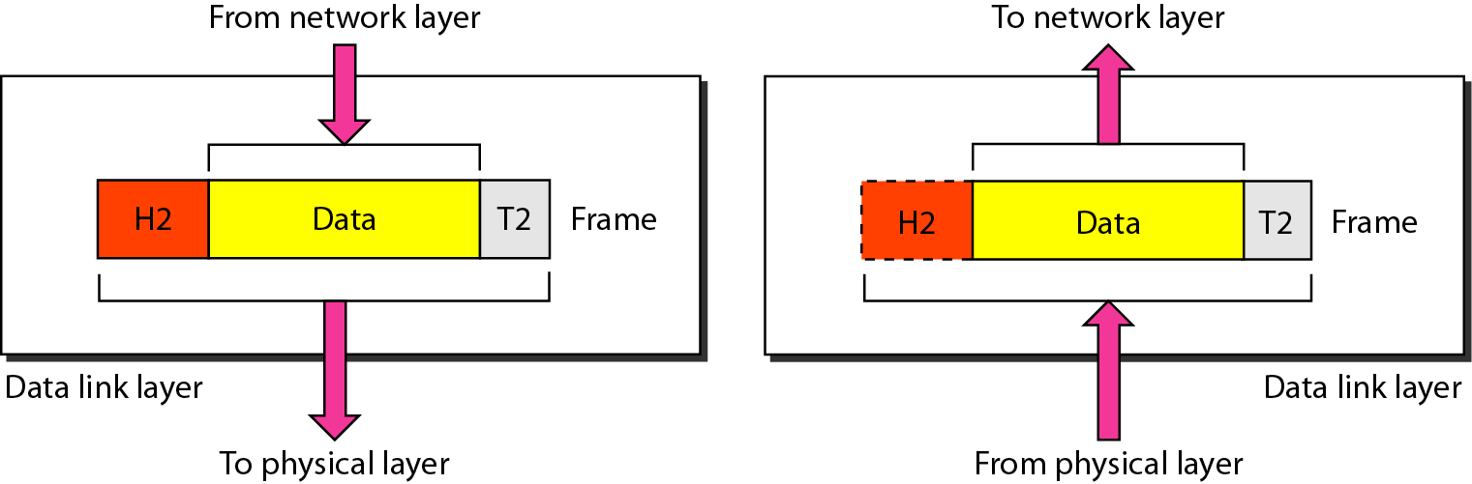
Data link layer (Cont....)
The data link layer is responsible for moving frames from one hop (node) to the next.
Source: Data Communications and Networking – Behrouz A. Forouzan

Slide 25
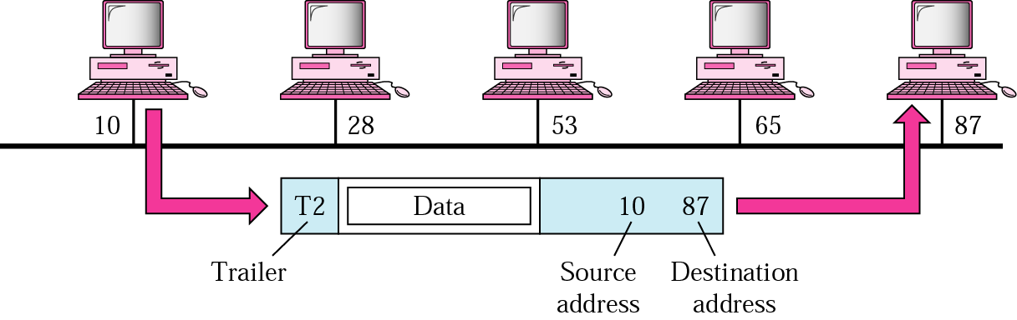
Data link layer (Cont....)

Slide 26
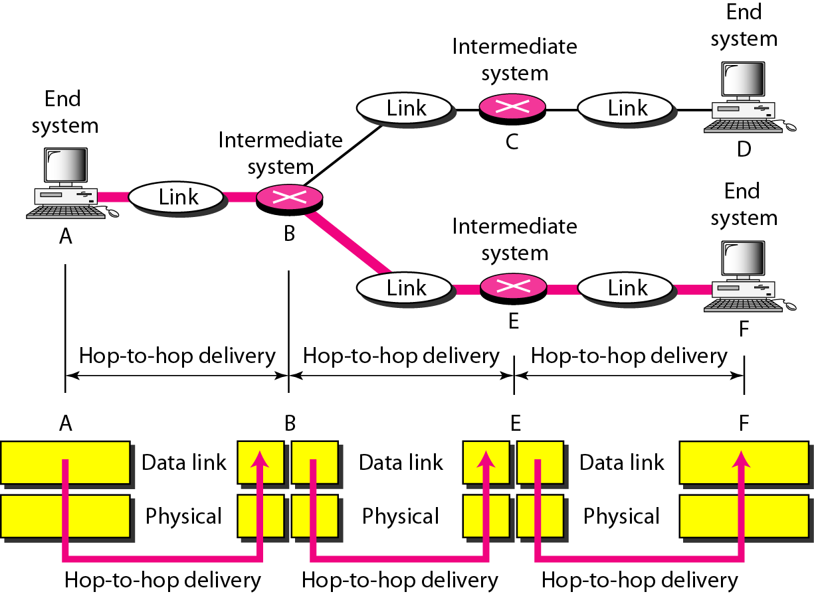
Hop-to-hop delivery
Source: Data Communications and Networking – Behrouz A. Forouzan

Slide 27
Network layer
The network layer is responsible for the delivery of individual packets from the source to the final destination.
(end-to-end delivery)
unit of communication is a Packet
Responsible for Source-to-Destination delivery of packets
Provides a mechanism to move packets between networks
Also handles packet switching and network congestion control
Responsibilities:
Network addressing (Logical Addressing)
Routing

Slide 28
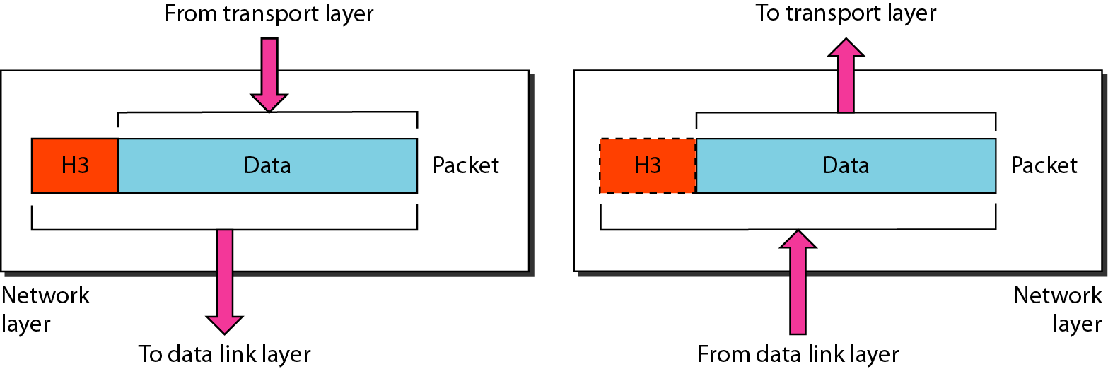
Network layer
The network layer is responsible for the delivery of individual packets from
the source host to the destination host.
Source: Data Communications and Networking – Behrouz A. Forouzan

Slide 29
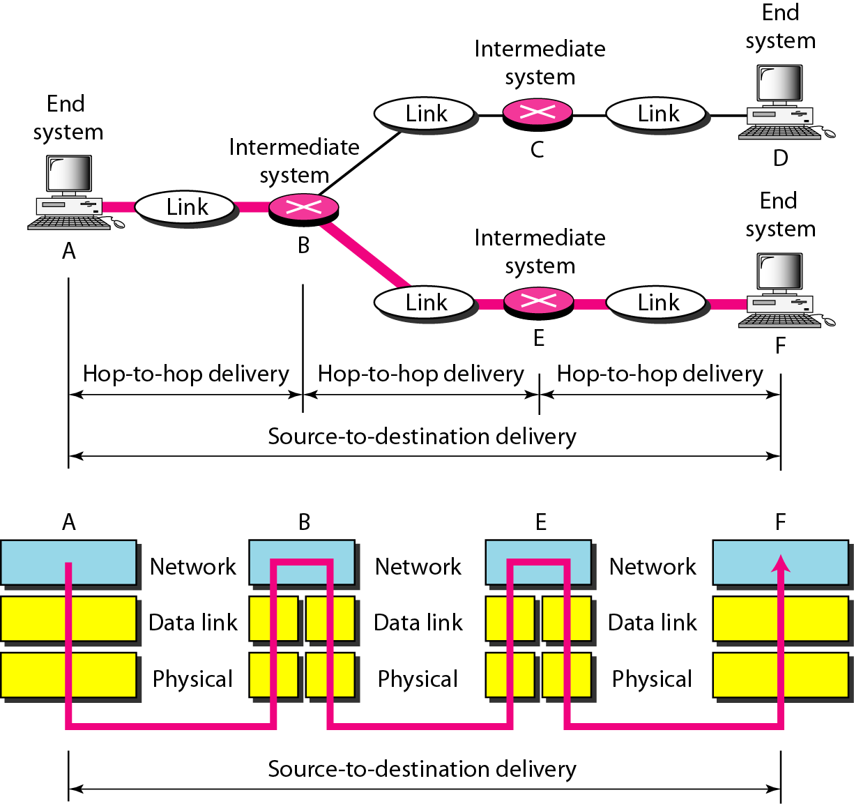
Source to destination delivery
Source: Data Communications and Networking – Behrouz A. Forouzan

Slide 30
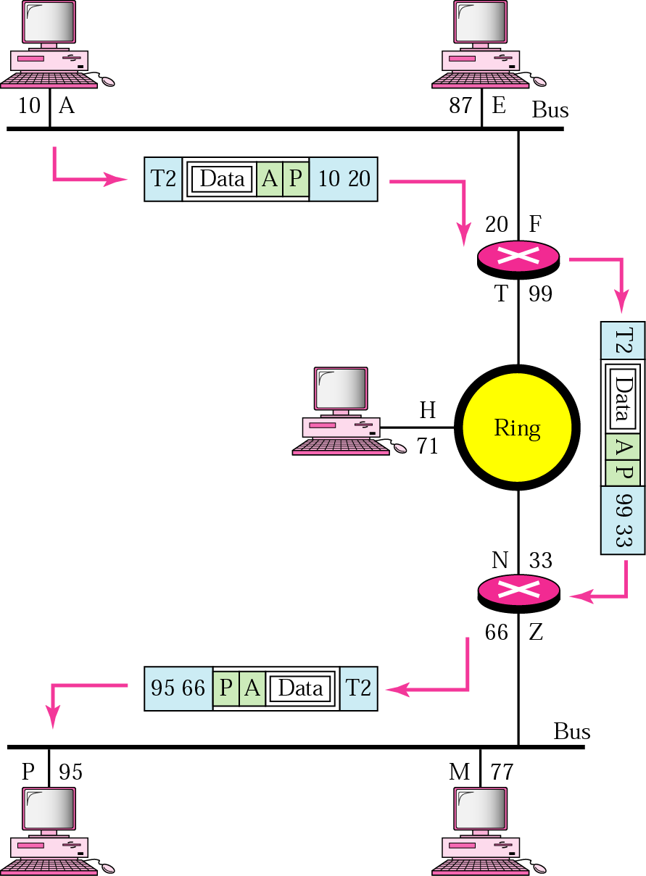
Network layer
Network Address
A , P
Physical Address
10, 95

Slide 31
Transport layer
The transport layer is responsible for the delivery of a message from one process to another
(source-to-destination delivery)
unit of communication is a Segment
provides reliable data delivery
receives information from upper layers and segments it into packets
Responsibilities:
Process-to-process communication [Header – Service point address]
Segmentation and reassembly
Connection Control

Slide 32
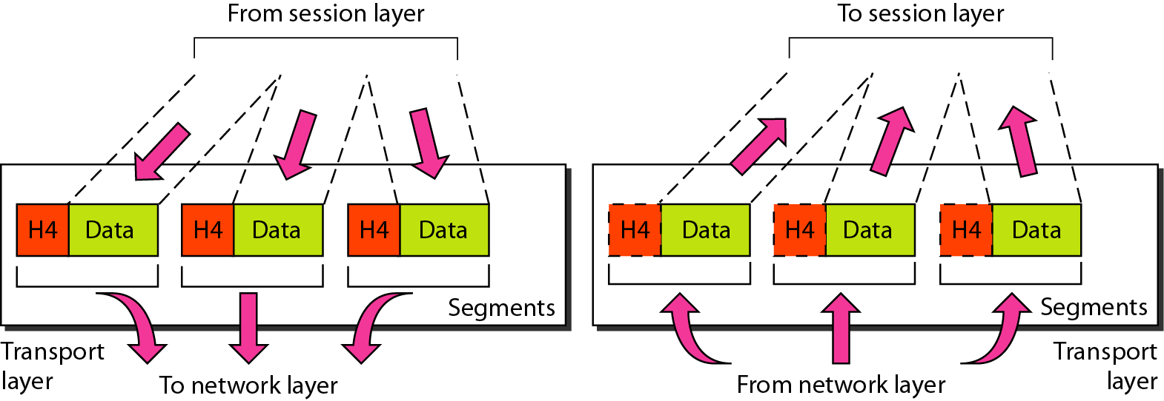
Transport layer
The transport layer is responsible for the delivery of a message from one process to another.
Source: Data Communications and Networking – Behrouz A. Forouzan

Slide 33
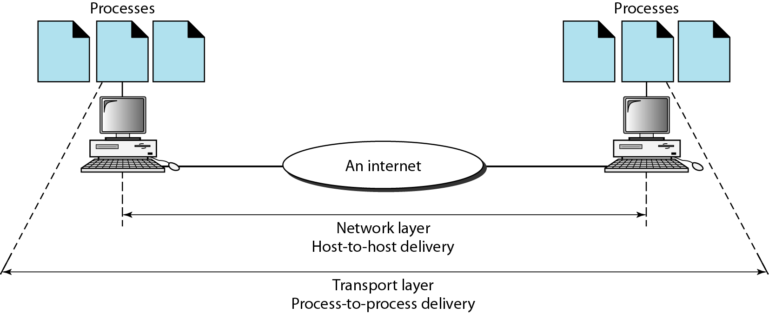
Reliable process-to-process delivery of a message
Source: Data Communications and Networking – Behrouz A. Forouzan

Slide 34
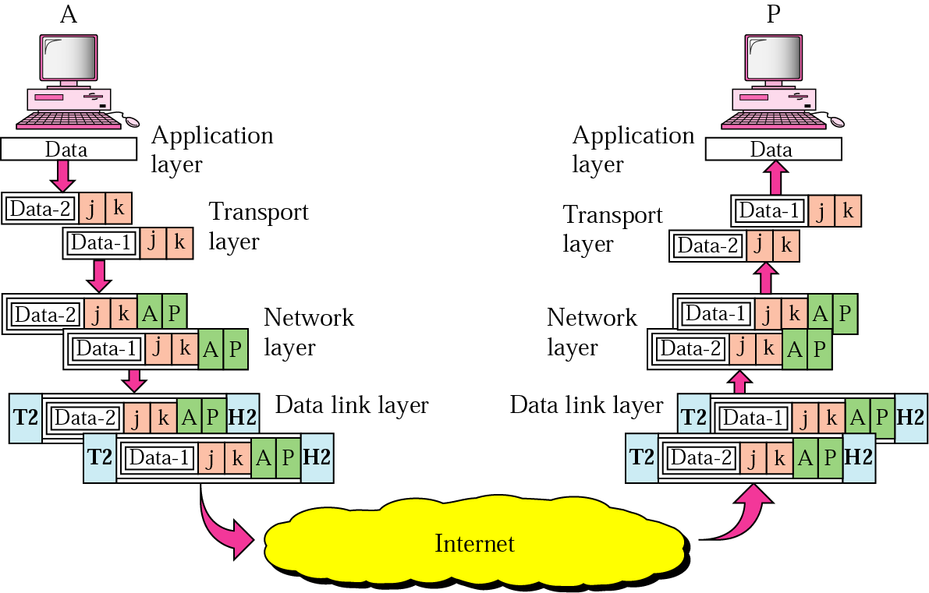
j – Address of sending application k - Address of receiving application

Slide 35
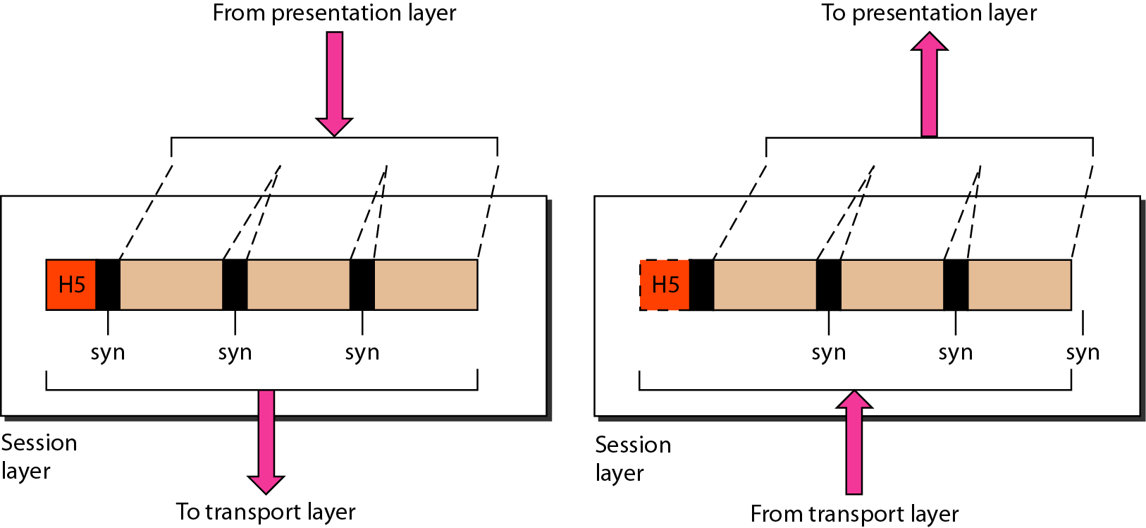
Session layer
The session layer is responsible for dialog control and synchronization.
Source: Data Communications and Networking – Behrouz A. Forouzan

Slide 36
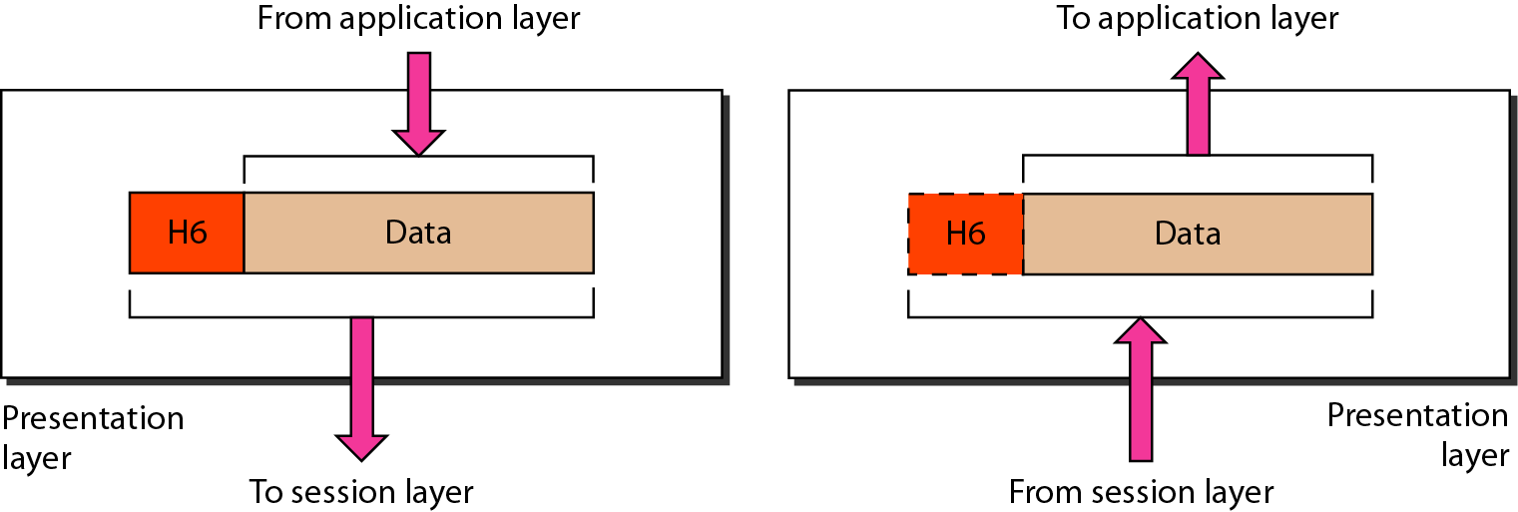
Presentation layer
The presentation layer is responsible for translation, compression, and encryption.
Source: Data Communications and Networking – Behrouz A. Forouzan

Slide 37
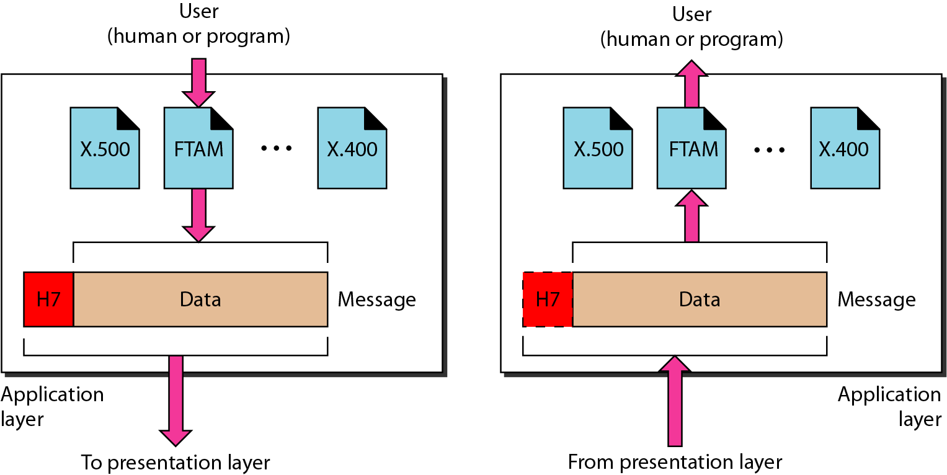
Application layer
The application layer is responsible for providing services to the user.
Source: Data Communications and Networking – Behrouz A. Forouzan

Slide 38
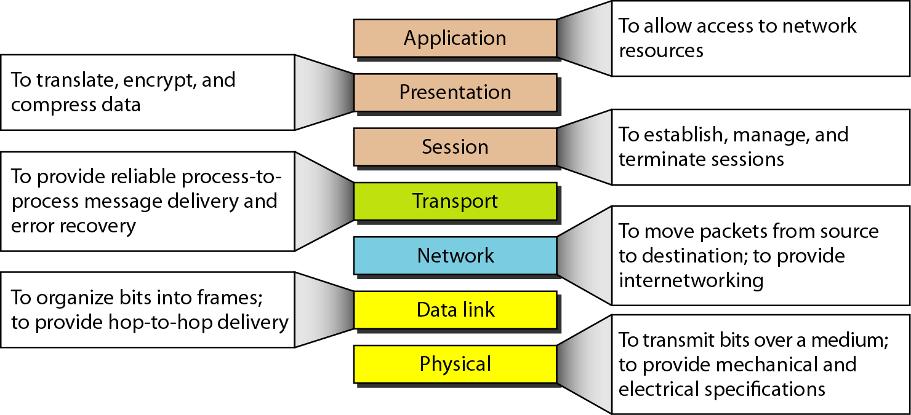
Summary of layers
Source: Data Communications and Networking – Behrouz A. Forouzan

Slide 39


Slide 40
TCP/IP PROTOCOL
DATA COMMUNICATION AND NETWORKING

Slide 41
TCP/IP PROTOCOL SUITE
The TCP/IP is compared to OSI, we can say that the TCP/IP protocol suite is made of five layers: physical, data link, network, transport, and application.
Topics discussed in this section:
Physical Layer
Data Link Layer
Network Layer
Transport Layer
Application Layer

Slide 42
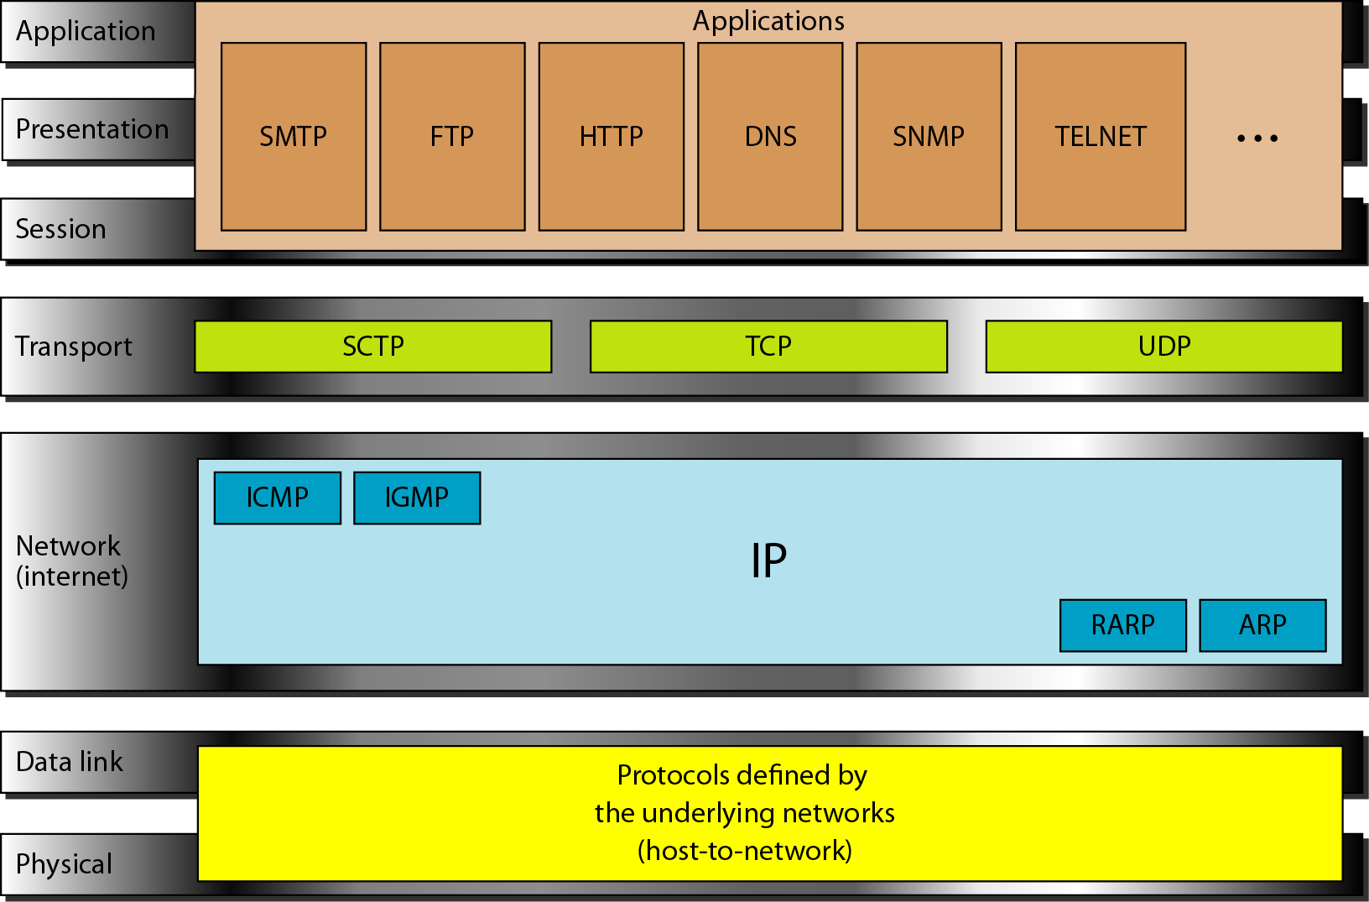
TCP/IP and OSI model
Source: Data Communications and Networking – Behrouz A. Forouzan

Slide 43
Addressing
Four levels of addresses are used in an internet employing the TCP/IP protocols
Physical Addresses
Addresses
Logical Addresses
Port Addresses
Specific Addresses

Slide 44
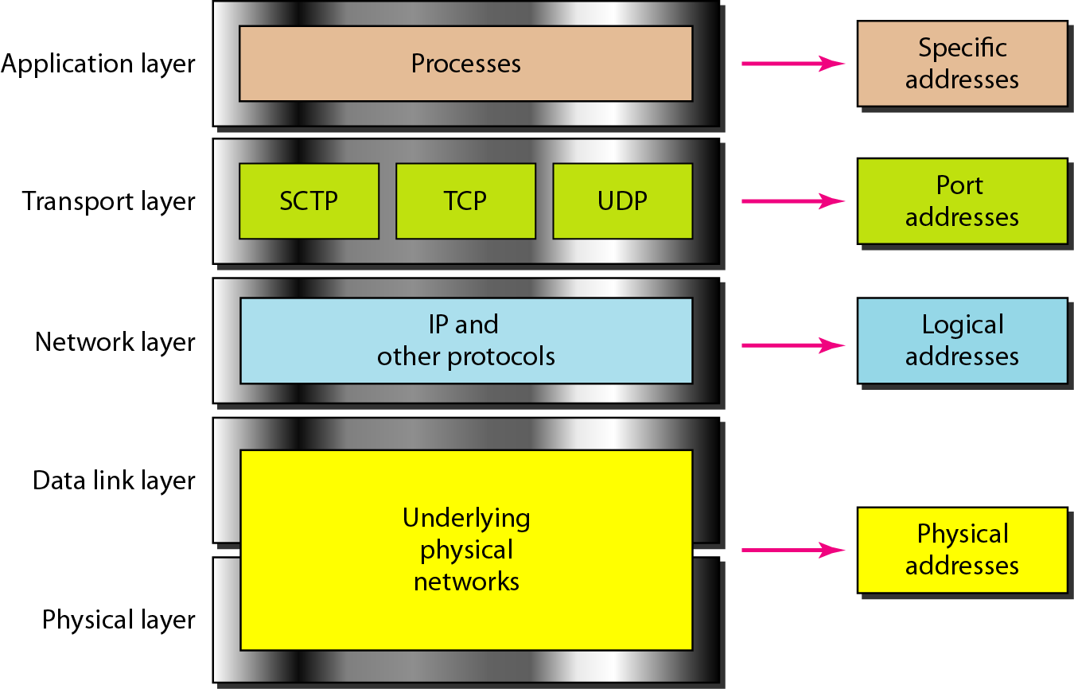
Relationship of layers and address TCP/IP
Source: Data Communications and Networking – Behrouz A. Forouzan

Slide 45
MAC address or Physical address
Most local-area networks use a 48-bit (6-byte) physical address written as 12 hexadecimal digits; every byte (2 hexadecimal digits) is separated by a colon, as shown below:
07:01:02:01:2C:4B
A 6-byte (12 hexadecimal digits) physical address
Source: Data Communications and Networking – Behrouz A. Forouzan

Slide 46
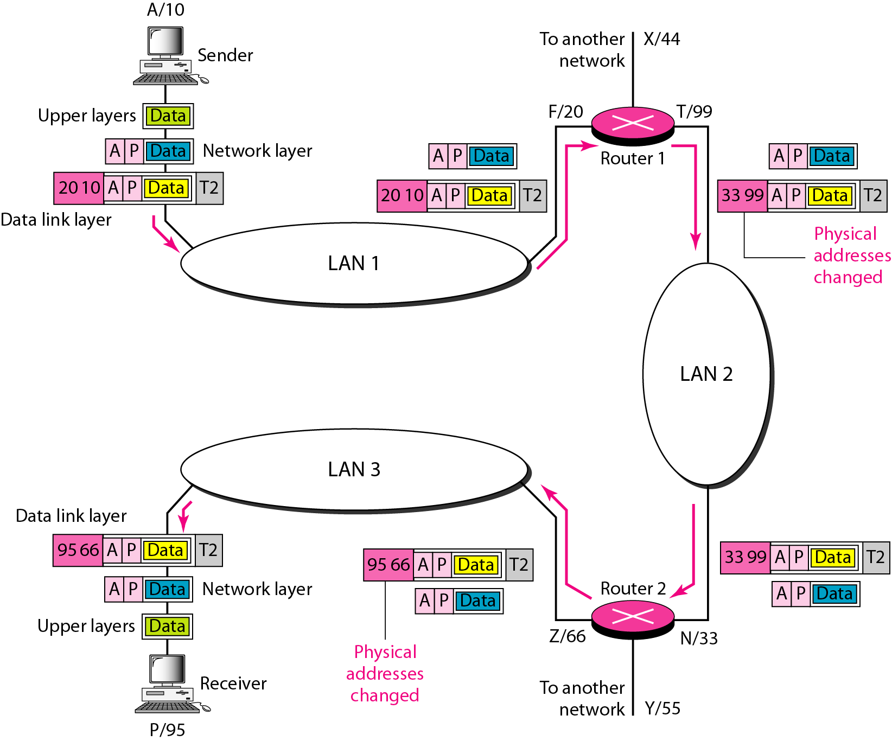
IP Address
The physical addresses will change from hop to hop,
but the logical addresses usually remain the same.
A logical address is a 32-bit(IPv4) or 128-bit(IPv6).
Examples
IPv4: 192.168.2.33 IPv6: 2dbe:ab67:237f:50cd:83fd:ab34:92bd:66ca
Source: Data Communications and Networking – Behrouz A. Forouzan

Slide 47
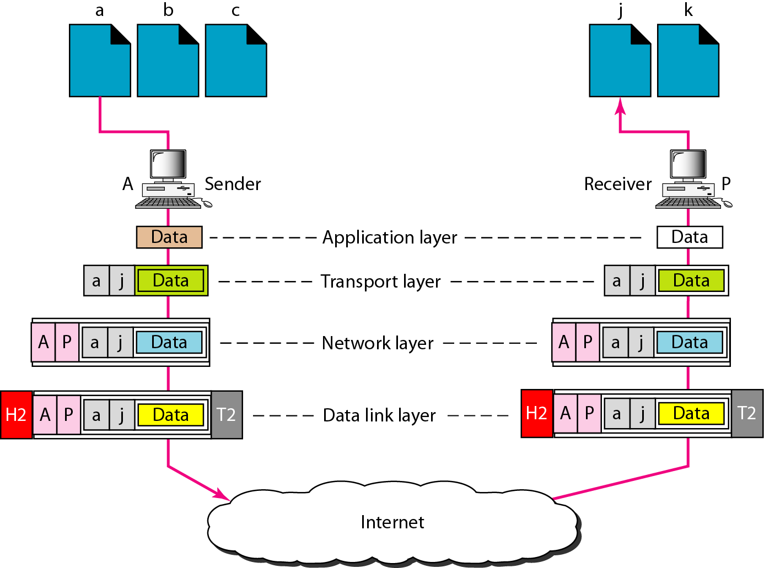
Port address
A port address is a 16-bit address represented by one decimal number. Ex.753
A 16-bit port address represented as single number.
Source: Data Communications and Networking – Behrouz A. Forouzan

Slide 48
Queries?
Thank You

